Slide 1
CHAPTER 2
POLAR COORDINATES

Slide 2
CONTENTS
2.1. Polar Coordinate System
2.2. Curves in Polar Coordinates
2.3 Areas & Lengths in Polar Coordinates
2.4. Conic Sections in Polar Coordinates

Slide 3
2.3 Areas in Polar Coordinates
We now develop a formula for the area of a region whose boundary is given by a polar equation.
Recall that the area of a sector of a circle is
θ

Slide 4
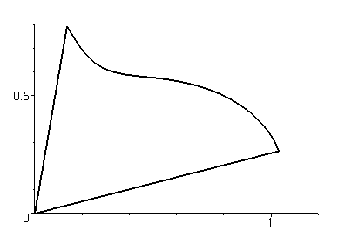
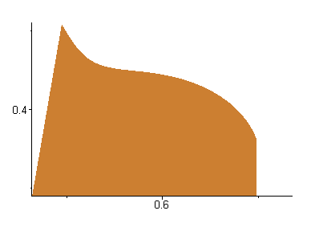
Let R be the region bounded by the polar curve r=f(θ) and the rays θ = a and θ = b, where f is a continuous function and 0 ≤ b – a ≤ 2π.
We divide [a, b] into n subintervals of equal width Δθ with end points θ₀=a, θ₁, θ₂, …, θ_{n}=b. Let θ₁*, θ₂*, …, θ_{n}* be sample points selected in these subintervals.
b
a

Slide 5
The ray θ = θ_{i} then divide R into n subregions with equal central angle Δθ.
The area ΔA_{i} of the i^{th} region is approximated by the area of the sector of a circle with central angle Δθ and radius f(θ_{ι}∗)
The total area A of R is approximated by

Slide 6
Passing to the limit we obtain
We also write this formula in the form

Slide 7
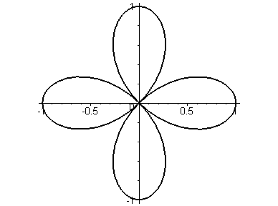
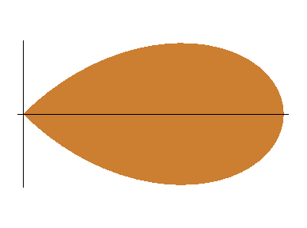
Example. Find the area enclosed by one loop of the four-leave rose r = cos 2θ
Solution. The region enclosed by the right loop is swept out by a ray that rotates from θ = - π/4 to θ = π/4.
Therefore we have
We use half angle formula and obtain
θ = π/4
θ =-π/4

Slide 8
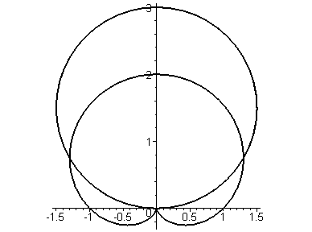
Example. Find the area of the region that lies inside the circle r = 3sinθ and outside of the cardioid r = 1 + sinθ
Solution. The values of a and b are determined by finding the intersections of two curves:
they correspond to the roots of 3sinθ = 1 + sinθ,
i.e. θ = π/6 or θ = 5π/6.
r=3sinθ
The desired area is the difference between the areas from θ = π/6 to θ = 5π/6 of the two curves
θ=5π/6
θ=π/6
r=1+sinθ

Slide 9
Note that the region is symmetric about the vertical axis
r=3sinθ
θ=5π/6
θ=π/6
r=1+sinθ

Slide 10
In general, the area of the region R bounded by the polar curves r=f(θ), r=g(θ), θ = a and θ = b, where f(θ)≥ g(θ) ≥0, and 0 < b – a ≤ 2π is given by
Note. Since a point has many representations in polar coordinates, we should graph the curves,
especially with the help of CAS to find all points of intersection

Slide 11
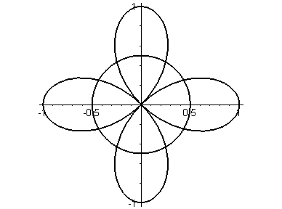
Example. Find all points of intersections of the curves r = cos2θ and r = 1/2
Solution. To obtain the points of intersection of two curves we solve : cos2θ = ½. The solutions are:
= π/6, 5π/6, 7π/6 and 11π/6.
The corresponding points are:
(1/2, π/6), (1/2, 5π/6), (1/2, 7π/6) and (1/2, 11π/6)
Using the graph we see that there are 4 more points which are, by symmetry :
(1/2, π/3), (1/2, 2π/3), (1/2, 4π/3) and (1/2, 5π/3)
(1/2, 2π/3)
(1/2, π/3)
(1/2, 5π/6)
(1/2, π/6)
(1/2, 7π/6)
(1/2, 11π/6)
(1/2, 5π/3)
(1/2, 4π/3)

Slide 12
Arc Length in Polar Coordinates
To find the arc length of a polar curve r=f(θ), a ≤ θ ≤ b, we regard θ as a parameter and write the parametric equations of the curve
x = r cosθ = f(θ) cosθ y = r sinθ = f(θ) sinθ
We have

Slide 13
Assume that f ' is continuous, then the arc length of the polar curve r=f(θ), a ≤ θ ≤ b is

Slide 14
Example. Find the length of the cardioid r=1+sinθ
Solution. The full length of the cardioid r=1+sinθ is given by 0 ≤ θ ≤ 2π . We have
We can use MAPLE to evaluate the integral and get
L = 8

